Slide 1
All About CanZell

Slide 2
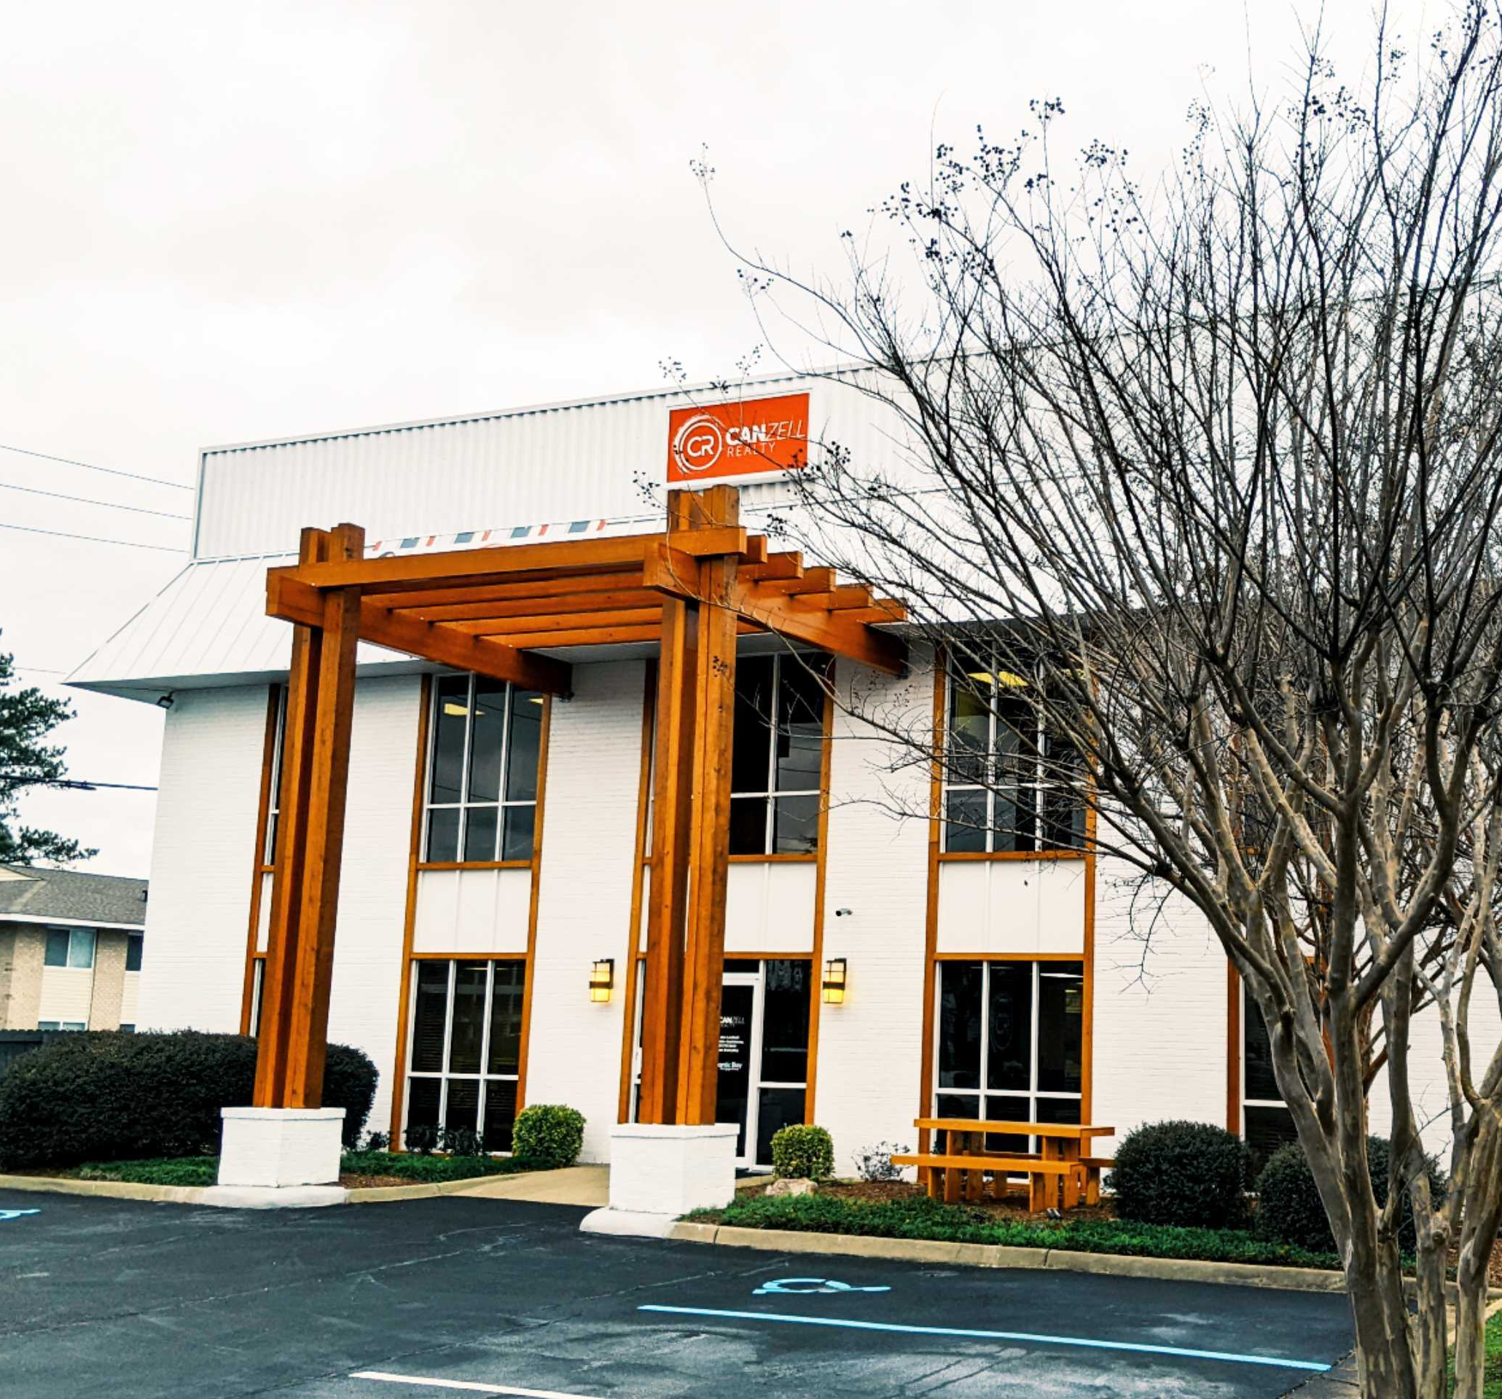
CanZell Realty is a National Brokerage that continues to grow in every state each day! CanZell Realty is a national, virtual, hybrid real estate brokerage. We have taken over your traditional brick and mortar brokerages. Our corporate headquarters is in Virginia Beach, VA. Most of our agents work from home, the beach, coffee shops – or wherever they want! Our agents do have access to shared workspace lounges across the country.

Slide 3
Our agents build their own businesses while having equity opportunities and rewards in the company. You can earn equity rewards of $250 of ownership stock after your first transaction!
At CanZell Realty there are always opportunities for growth! We are not a franchise model so agents are able to build their own business using all of the technology and tools we provide them.

Slide 4
When was CanZell Realty founded?
CanZell was founded in 2011 by Chantel Ray. As of January 2021, CanZell has opened operations in 16 US states and still growing.

Slide 5
Is CanZell Realty Sustainable?
A question a lot of agents have when they come across CanZell Realty is if the company is sustainable. Because CanZell Realty gives so much back to agents with Revenue Share, stock compensation, and lead generation tools, many agents wonder if the CanZell Realty business model can last into the future.

Slide 6
Is CanZell Realty Sustainable?
Our revenue share model pays out 85% of the company dollar back to agents, 11% to leadership and 10% to the charity of the client’s choice, allowing for the other 14% go towards overhead, technology and profit. Because CanZell Realty has no physical brick and mortar offices, the overhead is substantially less than comparable brokerages.

Slide 7
Leads
kvCore offers a service where agents can purchase leads for only $3-15 per lead. kvCORE is an all-in-one solution that gives agents their own lead-generating website and back-end CRM database.

Slide 8
$100
$50
Starting +
Monthly Fees
to join CANZELL
per month

Slide 9
Starting + Monthly Fees
What do the fees cover?
KV Core CRM & Website Platform
Every Canzell agent receives a free cutting-edge agent platform, kvCORE. This software offers agents a lead engine, web & IDX, smart CRM, listings, transactions, marketing autopilot, and business analytics.

Slide 10
Starting + Monthly Fees
What do the fees cover?
SkySlope
Transactions
SkySlope provides best-in-class solutions that work together seamlessly. Equip your team with the tools they need to work efficiently and provide the ultimate customer experience.

Slide 11
Starting + Monthly Fees
What do the fees cover?
Automated Marketing Materials
We offer our agents industry-leading marketing materials that can be created within minutes. With Breakthrough Broker, you can create content for social media, flyers, door hangers, post cards, and more with a click of a button.

Slide 12
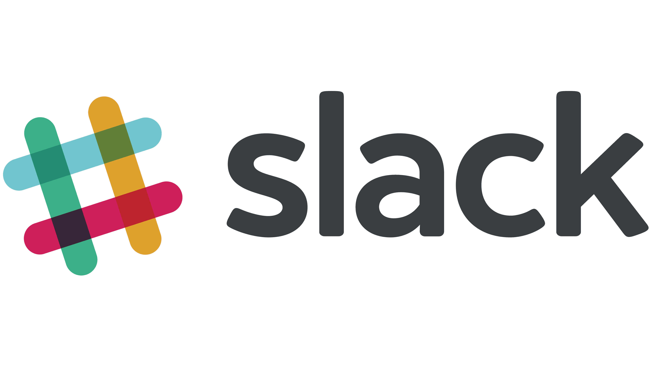
Starting + Monthly Fees
What do the fees cover?
Slack
Slack is a messaging app for CanZell Realty that connects people to the information they need. Slack is something CanZell Realty uses for any announcements, trainings, posts by agents and the corporate team, and so much more! There is unlimited messages in search, external partners in channels and more!

Slide 13
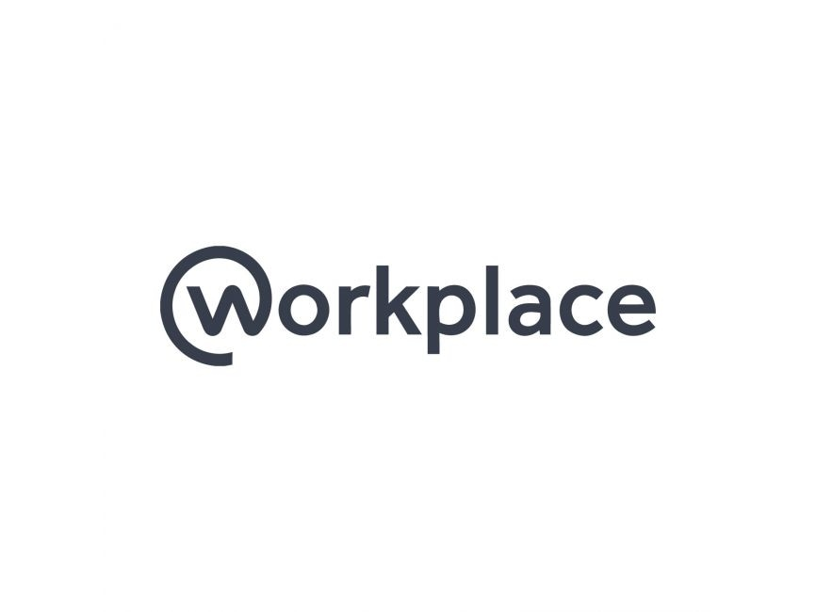
Starting + Monthly Fees
What do the fees cover?
Workplace by Facebook
Workplace is very similar to Facebook, however, it is a separate platform. Within Workplace, you have a news feed full of announcements, trainings, posts by agents and the corporate team, and referrals. You can join groups as well!

Slide 14
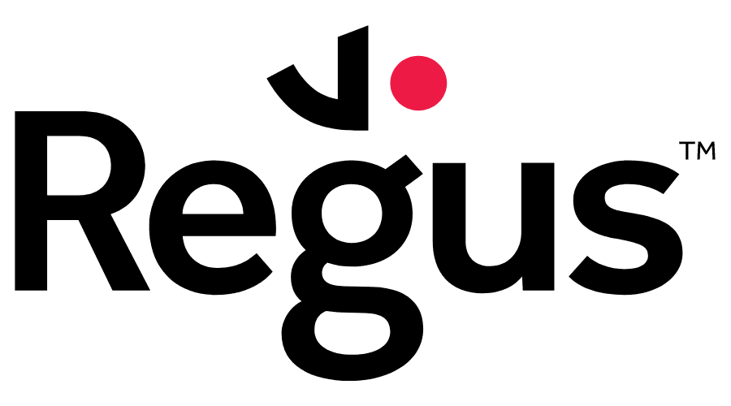
Starting + Monthly Fees
What do the fees cover?
Regus
Agents who join CanZell receive a free membership to the shared workspaces within Regus local offices. Regus is a nationwide coworking space. Agents can pop in, use WIFI, grab a coffee, and take care of work in over 3,000 locations across the US.

Slide 15
Starting + Monthly Fees
What do the fees cover?
CR University Virtual Training
Education is the key factor to anyone’s success. We provide live and on-demand training in our University Training Portal.

Slide 16
Starting + Monthly Fees
What do the fees cover?
ListHub House Listing
With over 1 billion (yes, with a B) page views, ListHub helps you gain maximum exposure for your listings while ensuring that your data and privacy are protected and accurate. At Canzell, we offer ListHub to our agents to ensure that your listings get in front of the right customers.

Slide 17
Starting + Monthly Fees
What do the fees cover?
Brokermint Transactions
Back-office automation with Brokermint drives your bottom line. Remove bottlenecks and move your brokerage forward from transaction management through commissions and accounting.

Slide 18
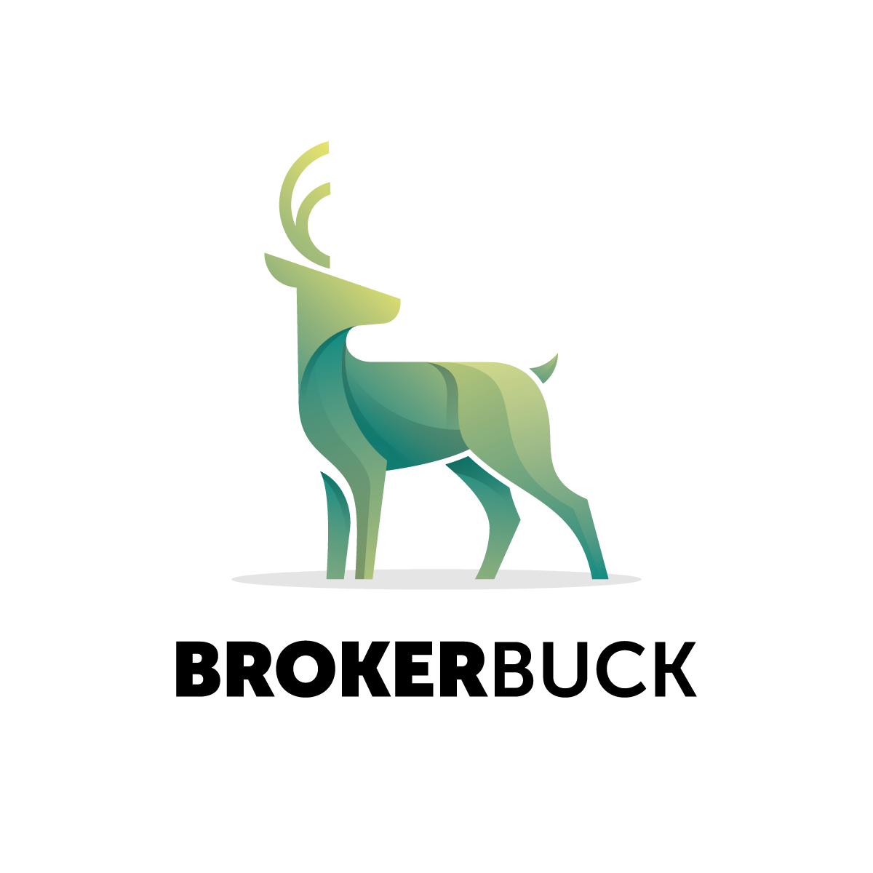
Starting + Monthly Fees
What do the fees cover?
Brokerbuck CRM and Referrals
Introducing Brokerbuck – our in-house, proprietary, all-in-one solution for all of your real estate needs. Gone are the days of needing a separate software for every need. Brokerbuck is now your CRM, Transaction Management, Referral Network, and much more – all in one place!

Slide 19
Starting + Monthly Fees
What do the fees cover?
Errors & Omissions Insurance
Our company has a $1M per claim professional liability insurance policy to cover any potential issues, inadequacies, and provide an umbrella of protection for agents and corporate staff.

Slide 20
Real-Time Support
One of the great things about CanZell Realty is the amount of leadership you have surrounding you. If you have a contract or broker question, you can go directly to your Broker. If you have a leadership or general question, you will go to your mentor, then your Circle Leader, then your Managing Partner and lastly your sponsor. They are all there to help answer all your questions to make sure you have a successful career at CanZell Realty.

Slide 21
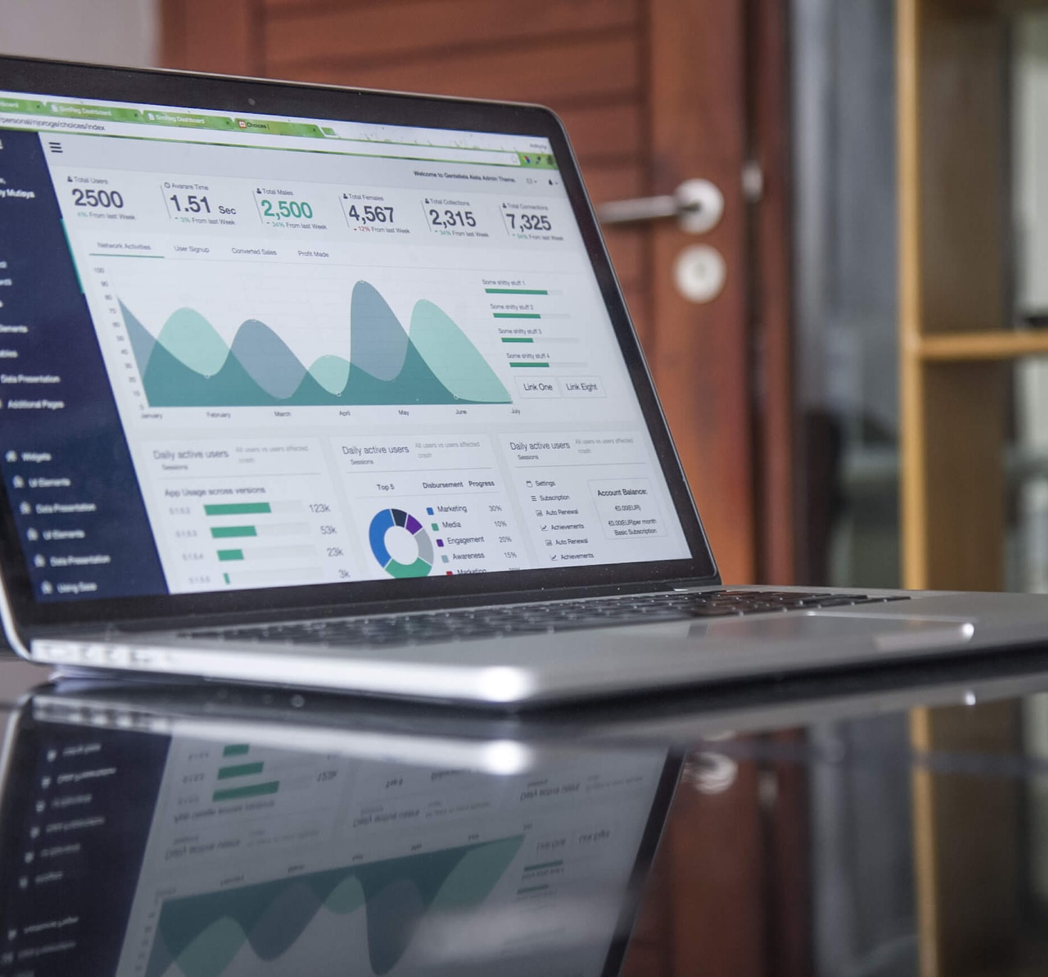
Transaction Management
CanZell Realty provides dedicated transaction support specialists to ensure agents files are complete and accurate! As I said previously, with the use of SkySlope, agents can turn in documents for review and receive any feedback instantly. Once these documents are reviewed and accepted, the transaction coordination team will create the commission disbursement authorization form to ensure that the agents will receive their commissions soon after closing!

Slide 22
Agent Collaboration
In addition to CanZell Realty staff, brokers, and circle leaders, agents will find tons of support from other agents! Workplace and Slack are great tools that agents communicate with; agents have questions answered within minutes!
Are here In-Person Trainings?
Yes! Our Circles get together on a regular basis to do everything from training and mastermind events, to fun outings and team bonding!

Slide 23
Selling Personal Real Estate Agents only pay a $395 Transaction Management Fee when buying or selling property in which they are on the title. They can do this up to 4 transactions each year in which they keep 100% of the ENTIRE commission.
Commission
Splits +
Fees
personal real estate
No franchise fees.
80/20
$14k
commission split
annual cap

Slide 24
Commission Splits
AGENTS AND TEAMS

Slide 25
Individual vs. Teams
Answers
When you join as an individual agent:
You will pay a full cap of $14,000
You will get $4000 back in stock rewards when you cap each year
You will qualify for the additional $10,000 back as an influencer if you obtain influencer status
You will receive $250 in stock rewards when you have your first closing and when anyone you sponsor has their first closing

Slide 26
Individual vs. Teams
Answers
When you join as a team agent:
You will pay a half or quarter cap based on which type of team member you are
You will pay your team leader a minimum of 25% to your team leader on every transaction
You will not be eligible for the $4000 back in stock awards when you cap
You will not be eligible for influencer status or rewards
You will receive $250 in stock rewards when you have your first closing and when anyone you sponsor has their first closing

Slide 27
Stock
Awards
Revenue
Share
Let’s talk abut keeping 100% of your commission

Slide 28
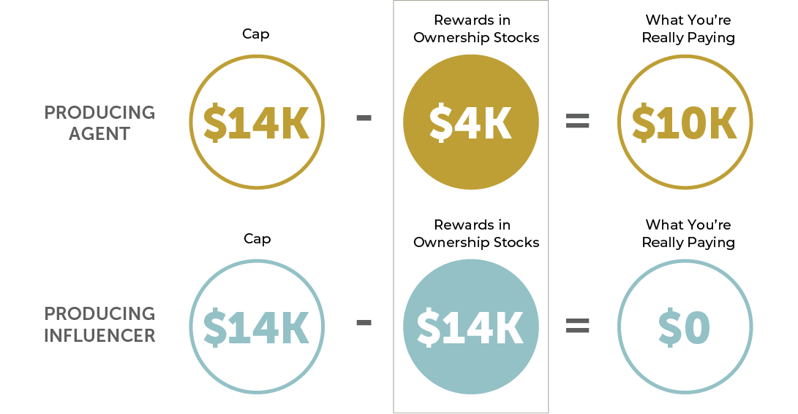
Commission Splits
PAY AS LITTLE AS
Pay as little as $0 in net commission.

Slide 29
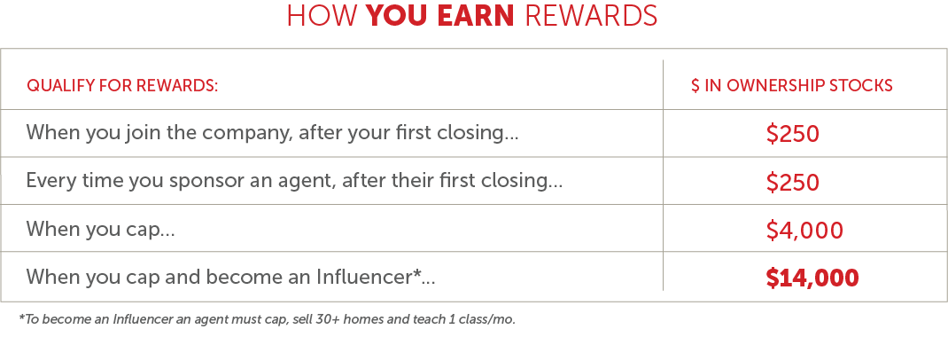
Commission Splits
EARN STOCK
Rewards?
We got ‘em.

Slide 30
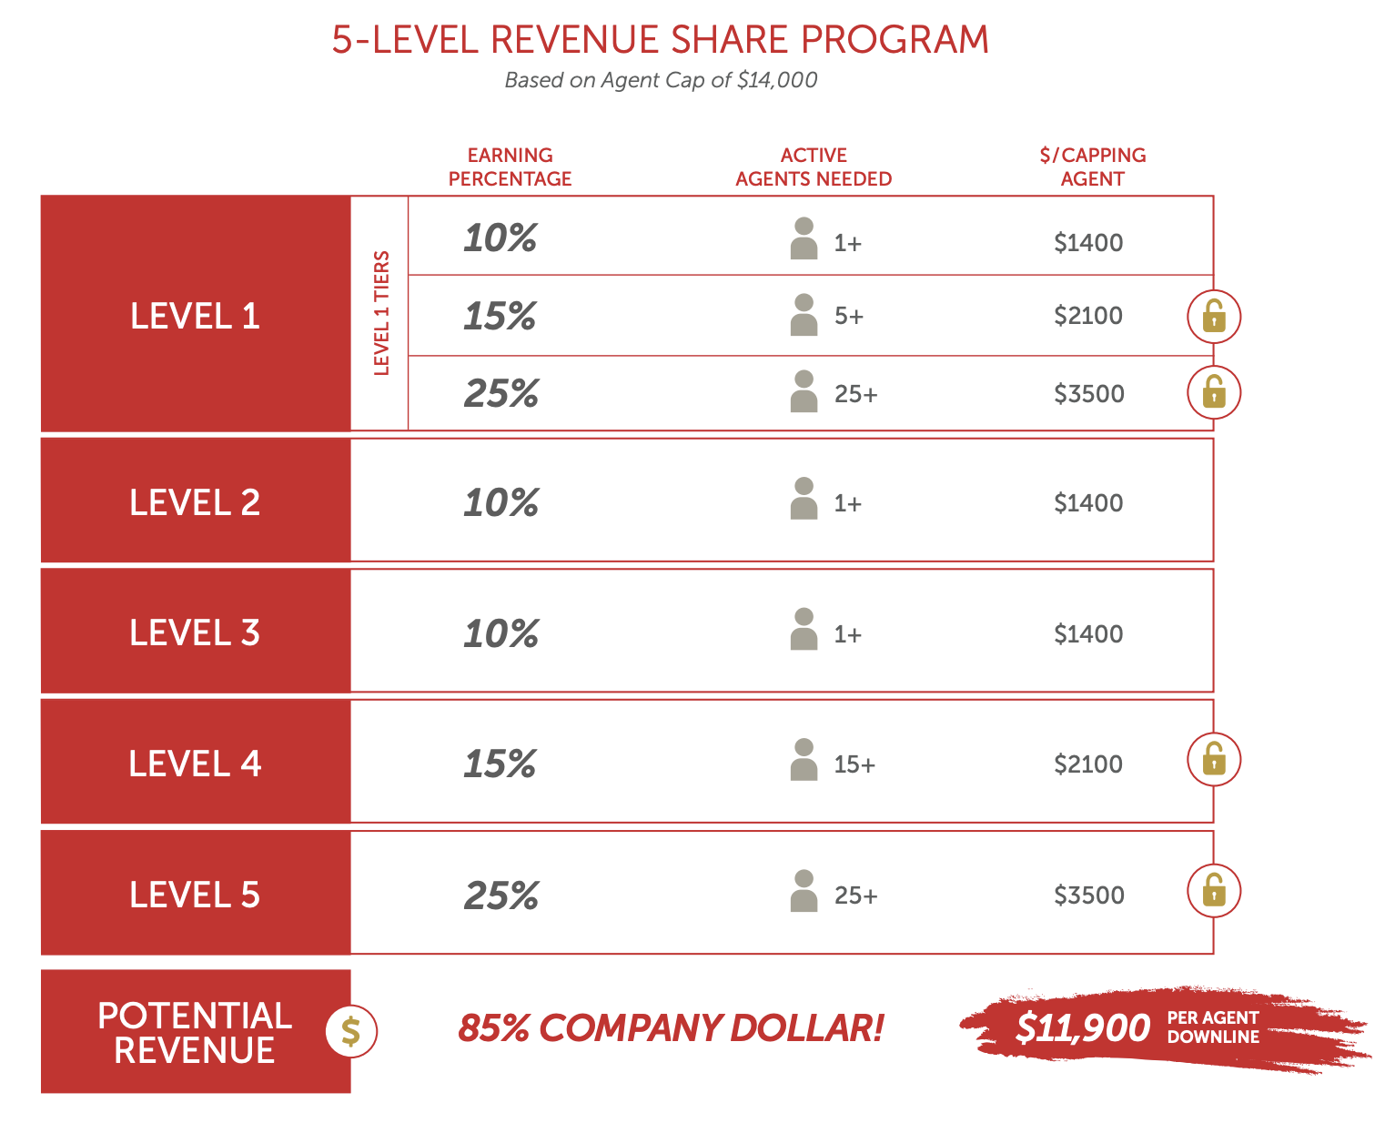
Revenue
Share
You can earn up to $3,500 on each agent each year! You will also receive a portion of the company dollar if any of those agents sponsor more agents. You will receive 10% of company dollar on Levels 2 and 3, and up to 25% on Level 4 and 5 once unlocked.

Slide 31
Revenue Share
Answers
What is a L1A vs a L1PA?
As an agent, you are either an L1A (Level 1 Agent) or a L1PA (Level 1 producing agent Agent) to your sponsor based on your production. When you close your first transaction at CanZell, you will be counted as an L1PA for 6 months. After that, every 12 month period that you close 2 transactions, you will be counted as an L1PA for your sponsor for that 12 month period. If you did not meet those production benchmarks, you will be a L1A to your sponsor.

Slide 32
Revenue Share
Answers
How do the bases work?
When an agent is in your base one, depending on how many active* agents you have under you, you will earn anywhere from 10% – 25% of the company dollar. If you have 1-4 active* agents, you will get 10% of the company dollar on any deal they close. If you have between 5-25 active* agents, you get 15% of the company dollar on any deal they close. And if you have 26+ active* agents you have sponsored, you get 25% of the company dollar they have closed. That means if you have 26 active agents, and one of them closes a transaction that has a TGC of $15,000 – you will get (20% of $15,000 is $3000) 25% of $3000, or $750, just from that closing.
*Agents must be producing. Agents are considered producing when they have closed a minimum of 2 homes or $5,000 in GCI in the last 6 months with our company. They need to close 2 homes or $5,000 in GCI at CanZell Realty in the prior 6 months to remain in producing status.

Slide 33
Revenue Share
Answers
Is there a limit on how much you can earn?
There is no limit on how much you can earn! You can earn up to $3,500 from each agent you sponsor in your Level 1 and then you can earn an additional up to 15% on all other Levels! The earning potential is limitless!

Slide 34
Revenue Share
Answers
How do you unlock Levels?
Levels 1 – 3 are automatically unlocked. In order to unlock levels 4 and 5 you must first unlock Level 1.*
Once you sponsor your first agent, you will receive 10% of the company dollar for each of the Agent’s closings until they cap. This Level payout is applicable when you have between 1-4 producing* agents within your sponsor.

Slide 35
Revenue Share
Answers
How do you unlock Levels? Continued
Once you have 5-24 producing* agents in your Level 1, your revenue share payout percentage increases to 15% of the company dollar on each transaction they close until they cap.
Once you have 25+ producing* agents in your Level 1, your revenue share payout percentage increases to 25% of the company dollar on each transaction they close until they cap.
*Agents must be producing. Agents are considered producing when they have closed a minimum of 2 homes or $5,000 in GCI in the last 6 months with our company. They need to close 2 homes or $5,000 in GCI at CanZell Realty in the prior 6 months to remain in producing status.

Slide 36
Revenue Share Willable
You can will your revenue share to an heir should you pass away or become incapacitated.

Slide 37
Revenue Share
Answers
There are 3 items that must be completed for revenue share to be willable.
CR and the CR Broker for that state must approve the change in sponsor to the heir.
Must provide legal documentation from an attorney stating that the heir has the right to the revenue share and it falls within state and federal guidelines.
Heir must become a licensed agent with CanZell Realty within 12 months of the passing or incapacitation of the agent, and have their real estate license in active status with CanZell Realty for their state.

Slide 38
Mentors
When joining CANZELL Realty, if you have closed less than 4 homes in the last 12 months, you will be assigned a mentor. This mentor will assist you through your first 4 closings. They will receive 25% of your agent portion of your commission for mentoring you.

Slide 39
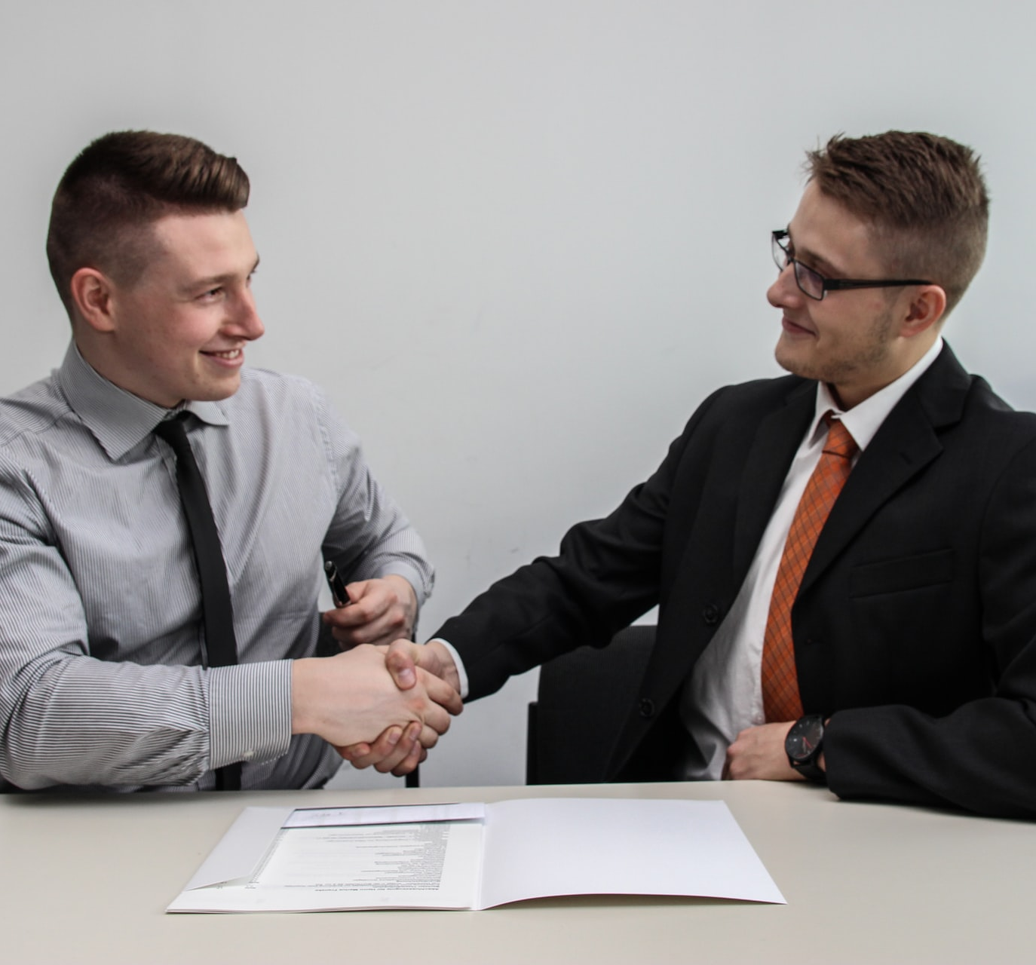
Pick Your Sponsor
Your sponsor is the person that introduced you to CANZELL Realty. If you spoke with multiple people before deciding to join CANZELL you should name the sponsor that was the “procuring cause” or in other words, WHO WAS THE MAIN PERSON who helped you say YES! to our FAMILY at CANZELL.

Slide 40
Sponsors
Answers
Can I change my sponsor?
You have 30 days to change sponsors if there was an error. This is only for an error so make sure you check right away.

Slide 41
Sponsors
Answers
If I’m returning to CanZell Realty, can a pick another sponsor?
If you leave the company for at least six months, you can select a different sponsor upon your return to CanZell Realty.

Slide 42
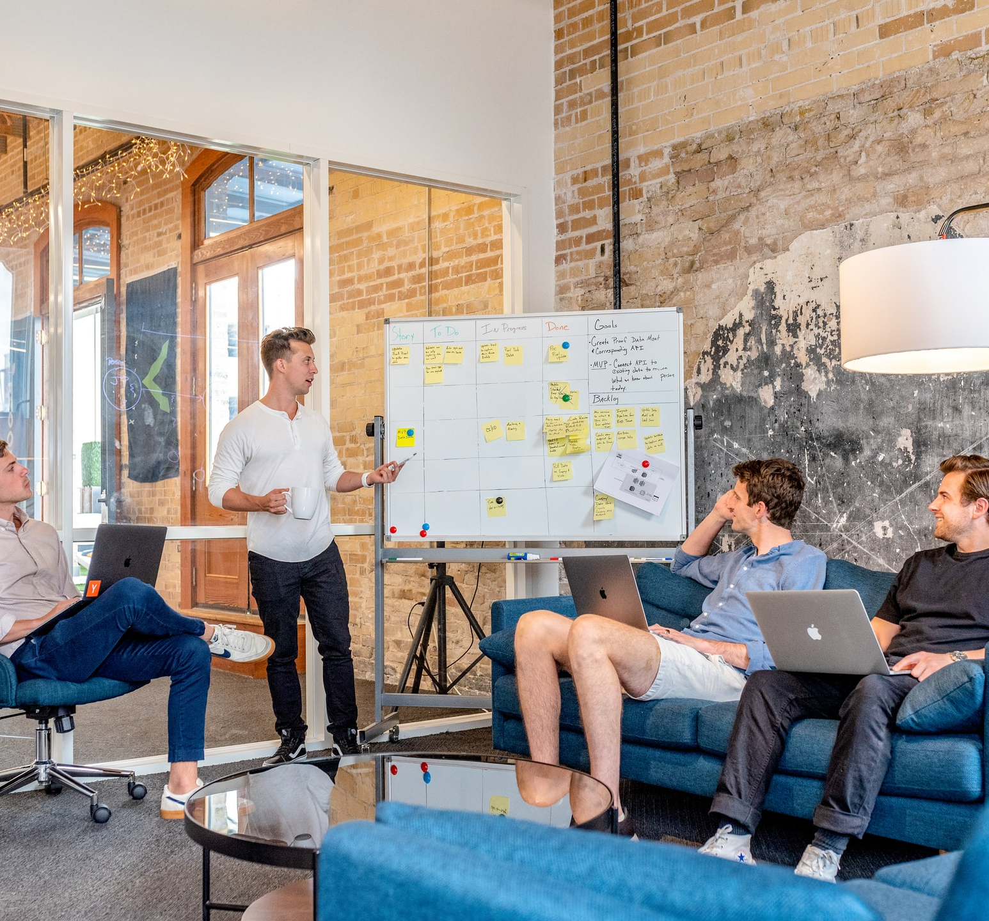
Influencer
CanZell celebrates all our agents while highlighting those who achieve exceptional sales transaction numbers and exemplify our core values. We recognize agents by offering them the opportunity to earn Influencer status. Influencer status is reserved for those agents who cap and close 30 or more transactions during their anniversary year, teach a class, and operate in alignment with our core values.

Slide 43
Influencer
Answers
When will I be recognized publicly as an Influencer?
Once you hit Influencer status, you will receive a social media post via email to post on your personal social media sites. We will also post a graphic and congratulations in the company internal Facebook page.

Slide 44
Influencer
Answers
Can I apply production at my former brokerage to CanZell to help me achieve Influencer status?
When onboarding, you can present your last 12 months production from your previous brokerage to be granted Influencer status.

Slide 45
Influencer
Answers
Can I pay the company commission cap upfront so I can become an Influencer faster?
Every agent must pay their cap by contributing 20% of their Total Gross Income per transaction. You are not able to pay more or out of pocket.

Slide 46
Exclusivity
Answers
I want exclusive rights to an entire state, how do I get that?
There are no exclusive rights to a state, which is a really great thing because everyone can sponsor agents in every state, growing their revenue share!
Each state does have a designated broker, that oversees all agents and all Managing Broker’s in a state. They receive 3% of the company dollar of any circle they are the Managing Broker of, and 1% of the company dollar of any circle they are overseeing the Managing Broker.

Slide 47
Circle Leader
Answers
If I am a circle leader, do I have to recruit every person in my circle, or will you send me people to add to my circle?
As a circle leader, you have the ability to sponsor and add as many agents to your circle as you want. If a recruiter or another agent sponsors an agent in your area, they will also send them to your circle.

Slide 48
Getting help
BOA:
boaall@canzell.com
Technical Help:
help@canzell.com
Transactions:
transactions@canzell.com
Billing, Commissions, and Accounting Help:
accounting@canzell.com
Revenue Share:
revshare@canzell.com
OptionTrax:
support@optiontrax.com

Slide 49
Ready to jump in?
Go to JOINCANZELL.COM and click on the red tab that says, ‘Onboard Now’. Click on ‘Agent Join Now’. Fill out the application, it doesn’t take long at all.
1

Slide 50
Ready to jump in?
Once you have completed the application, CanZell Realty will send you the independent contract agreement. You will sign this electronically and name your sponsor at the very end.
2

Slide 51
Ready to jump in?
Upon completion, you will receive an email from or administrative team letting you know how to transfer your state license over to CanZell Realty.
3

Slide 52
LEARN MORE
JOINCANZELL.COM

