Slide 1
Why I Joined CanZell

Slide 2
The number one thing we would like for you this year is for you to take advantage of the revenue share and the ownership stock in the company.
As we grow, one of our biggest intentions is to become a publicly traded company. And when we do, you can take your stock and sell it on the open market. And as soon as we go public, all of your shares will vest immediately. So, we're really excited about that.

Slide 3
So the best way for us to explain our vision is to discuss some similar examples. Uber took over taxicabs, Netflix took over Blockbuster and we want to take over traditional brokerages.

Slide 4
When Blockbuster first heard about Netflix, it was actually Netflix that went to them wanting to partner, but Blockbuster turned them down.
And six years later, Blockbuster went bankrupt.

Slide 5
The Hilton may be the largest hotel chain, but Hilton is not a cloud based company.
Airbnb is now worth $100 billion. Hilton is worth $25 billion. That's huge.

Slide 6
Our Model
Life is changing and so is cloud based technology, and we believe the best growth potential is in the cloud based sector.

Slide 7
Our Model
So with us, at one point, we had 7 locations within a 20 mile radius, but none of the agents were coming into the office. We were putting all of our money into these buildings that no one was coming into.

Slide 8
Our Model
What If I Want To Work In An Office?
Regus
If you say, “Hey, I'm an agent that wants to work out of an office”, well, you can, because you can work out of Regus! There's 3,000 of them all across the country. These Regus locations are fully staffed. You will have an office space if you want it, plus wi-fi, they've got coffee, they've got a receptionist, and more!

Slide 9
The CanZell Difference
Why Should I Join?
And you know, one of the things that you have to remind yourself is that when you join CanZell, you now are an owner of CanZell Realty.
When you work at other national brokerages, you're not going to be an actual owner of the company. Yes, you might get profit share, but profit share is a totally different beast than revenue share.

Slide 10
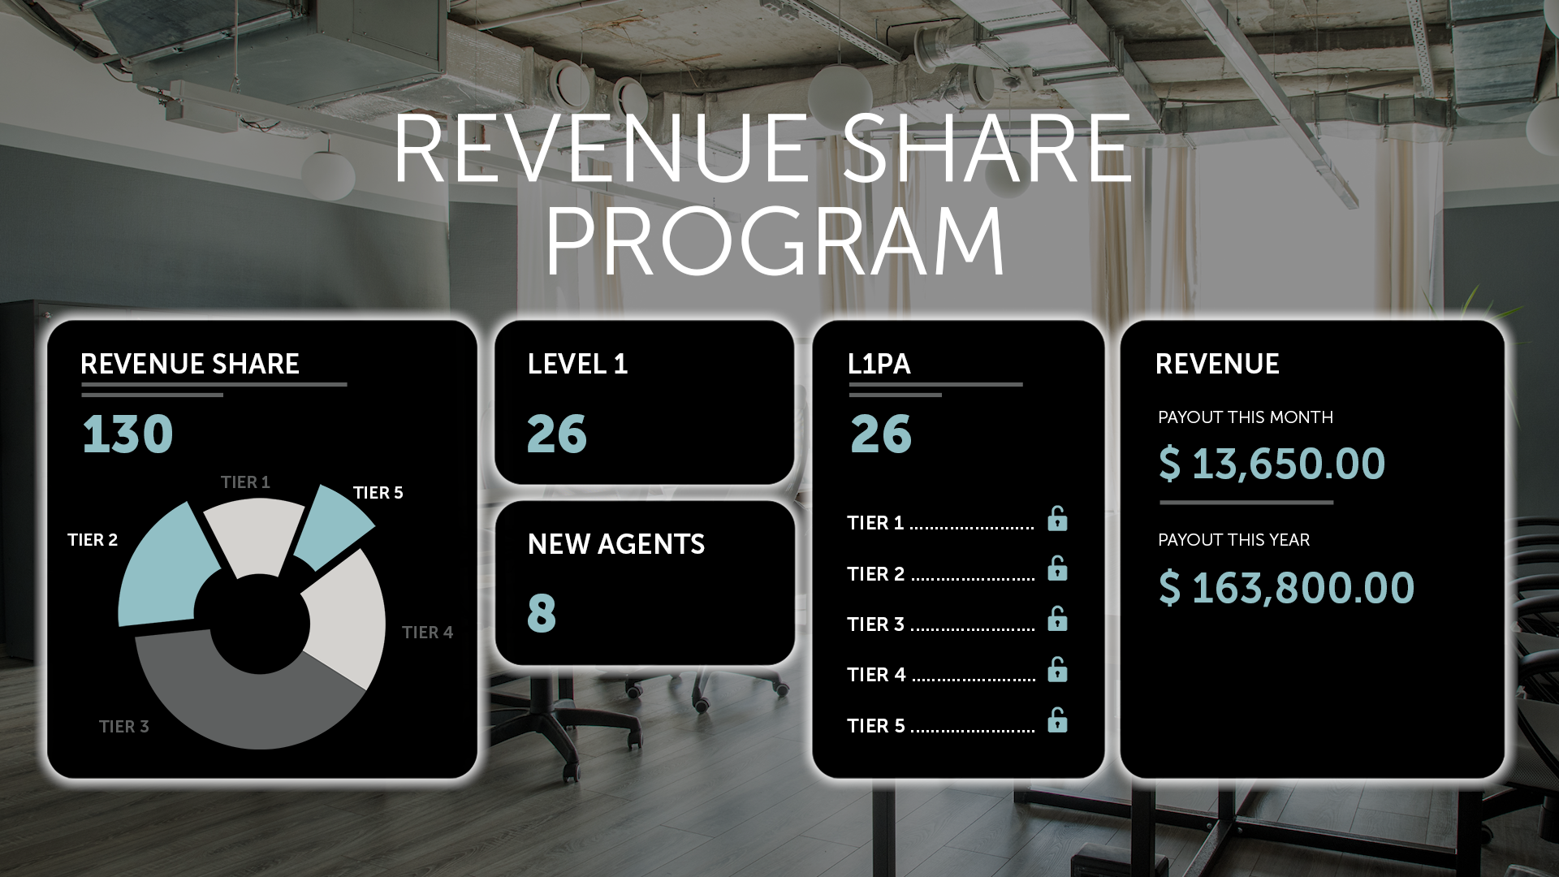
The CanZell Difference
Why Should I Join?
Revenue share means when we get a dollar in, this is how much you get back with profit share. Will they take out expenses? How much was the overhead?
There are a lot of people at other brokerages, who are maybe making $20 a month in profit share. That's not going to be life changing for you.

Slide 11
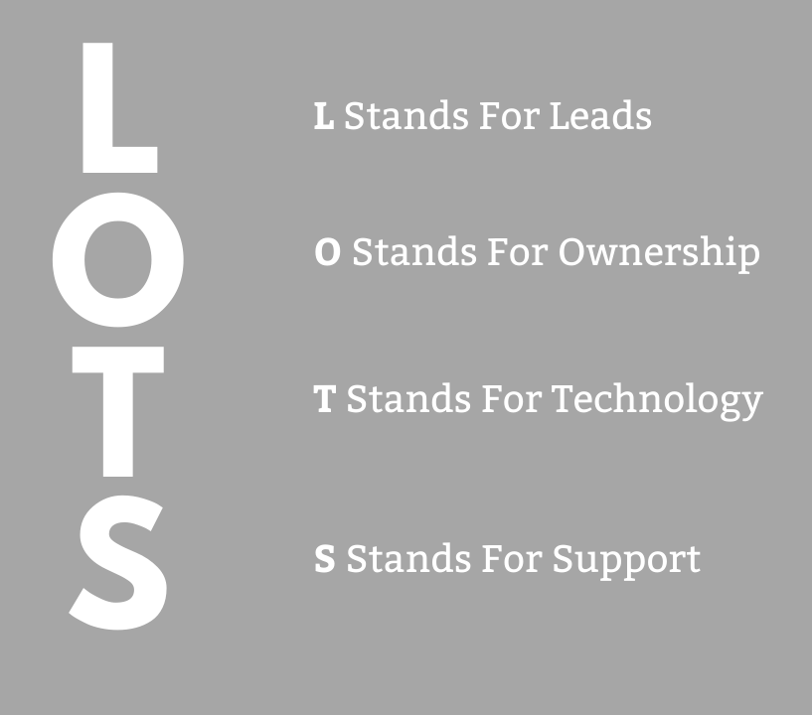
Let's Talk About L.O.T.S.
What Does L.O.T.S. Stand For?
At CanZell, we believe in L.O.T.S., our acronym for Leads, Ownership, Technology, and Support.

Slide 12
Let's Talk About L.O.T.S.
L Stands For Leads
L Stands For Leads
We've partnered with Kv Core for leads. You can get these leads for $3 to $15 a lead. That is such a huge, drastic change on how much the price per lead is.

Slide 13
Let's Talk About L.O.T.S.
L Stands For Leads
So you don't have to hire a Google AdWords company, or hire a Facebook company. With Realtor and Zillow.com, if you can get leads with them for less than two hundred dollars a lead, you are lucky.
With Kv Core, you can, in three clicks, get these leads. If you're not doing that right now and buying those leads, make a commitment this year to do that.

Slide 14
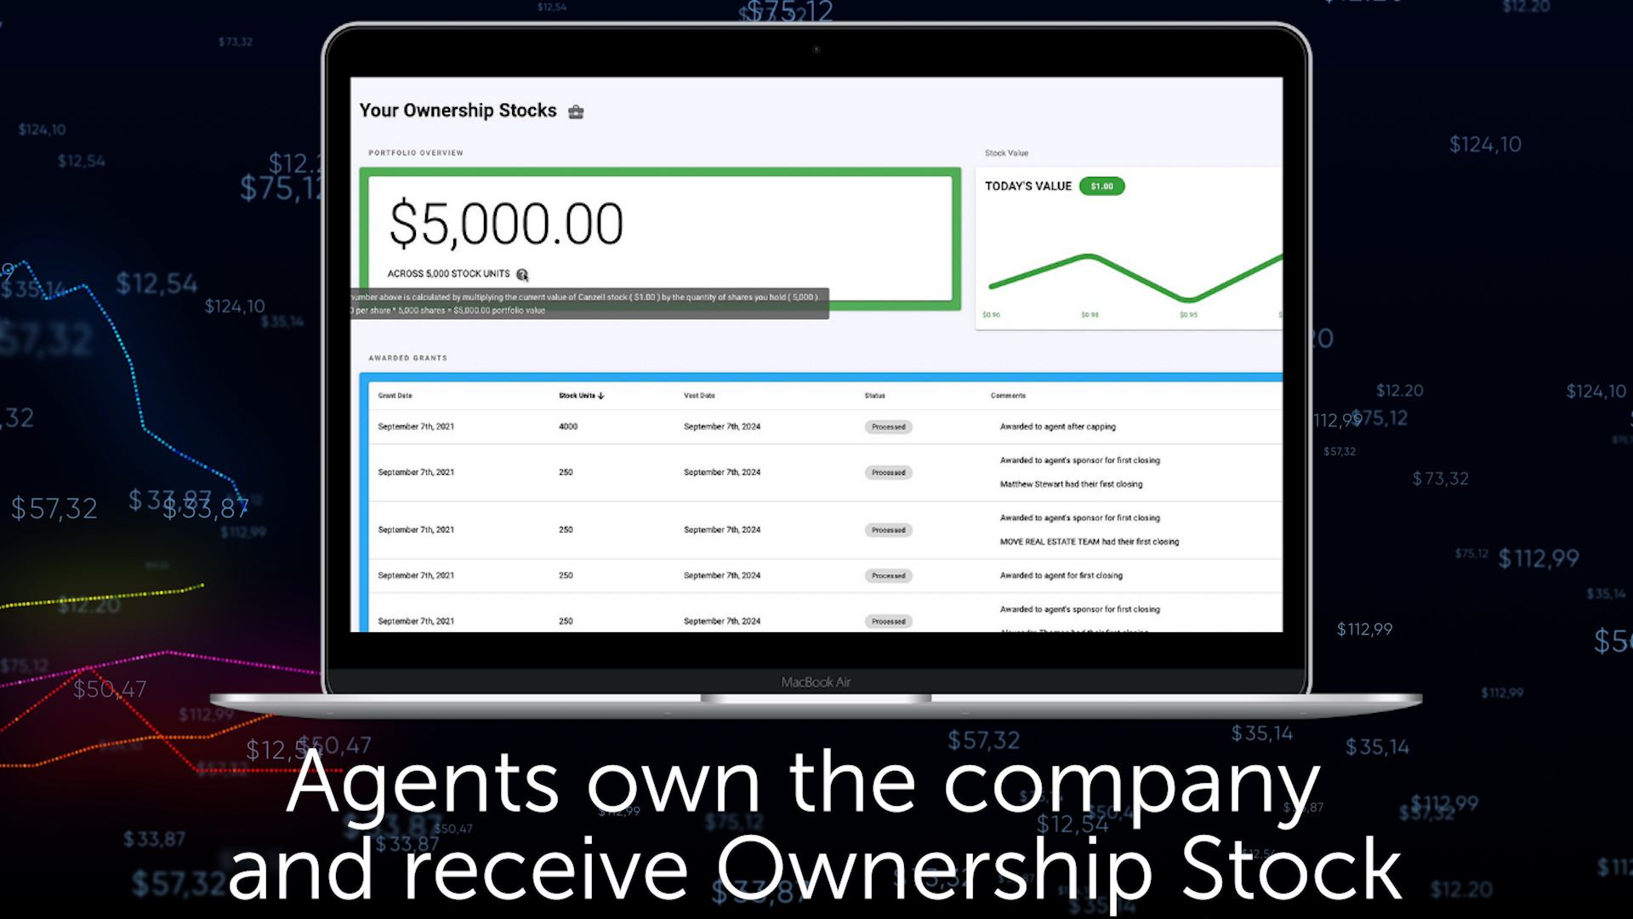
Let's Talk About L.O.T.S.
O Stands For Ownership
O Stands For Ownership
When I first became an agent, I worked for a company, and I got tons of plaques. I was the number one agent. Number one agent in the region number one in this. And guess what? All those plaques? I've recently thrown all of those away. They are nothing but trash. You don't want plaques. What you want is you want equity and stock in the company.

Slide 15
Let's Talk About L.O.T.S.
O Stands For Ownership
Elsewhere, you might get profit share, but that's very different from revenue share.
You are working for billionaires instead of you being an owner in the company and having ownership.

Slide 16
Let's Talk About L.O.T.S.
O Stands For Ownership
When you have a piece of ownership with a company that's planning to go public, it's very exciting.
Look at the people who started at the very beginning with Uber. Look at the people who just started in the very beginning with Apple. Those people are sitting pretty right now.

Slide 17
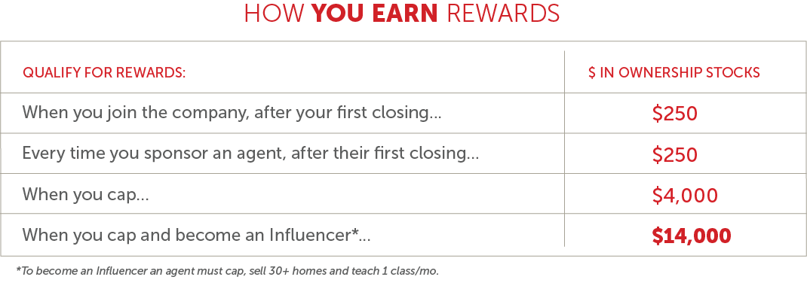
Let's Talk About L.O.T.S.
O Stands For Ownership
So as a reminder, the day you join, you're making $250 in ownership stock. The day you bring another agent on your when and their first closing, you're getting $250 in ownership stock.

Slide 18
Let's Talk About L.O.T.S.
O Stands For Ownership
When you cap, which means you're only bringing $14,000 to the company, when you cap, you get $4,000 of that back in ownership stock.

Slide 19
Let's Talk About L.O.T.S.
O Stands For Ownership
And when you close 30 homes, you're getting all $14,000 of that back, every bit of it in ownership stock.
And because you're getting it in stock, the likelihood of that increasing in value is very high.

Slide 20
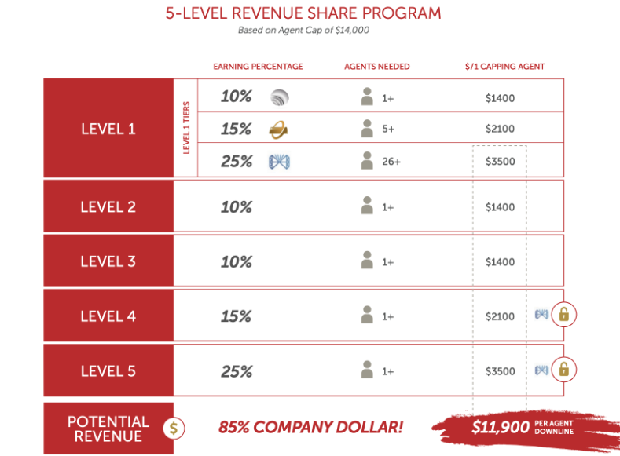
Let's Talk About L.O.T.S.
O Stands For Ownership
So, you can make up to 85% of the company dollar in the down line.
That's like $11,900 in each down line. That's a huge amount of money! With us, this is a really big difference.

Slide 21
Let's Talk About L.O.T.S.
O Stands For Ownership
The Level 2 and Level 3 downlines, they open up immediately. So if you're not a great recruiter but you bring on a couple people who are heavy hitters, guess what?
You don't have to hire 5 or 10 agents to open up those tiers. You automatically get those. So that's what makes us very different.

Slide 22
Let's Talk About L.O.T.S.
O Stands For Ownership
Another thing that makes us different is that at other companies, in order to count that person in your downline, they have to have sold 4 houses per year? With us, it's only 2 houses per year, with the average agent only selling 3 houses per year.

Slide 23
Let's Talk About L.O.T.S.
O Stands For Ownership
That's a very big difference and a big deal. And here's the thing; if that agent stays with us for 10 years, 15 years, you're getting that money every single year.

Slide 24
Let's Talk About L.O.T.S.
O Stands For Ownership
I want to show you the revenue share calculator.
If you go to JoinCanZell.com and click on Revenue Share Calculator, you're going to see how much money you can make.

Slide 25
Let's Talk About L.O.T.S.
O Stands For Ownership
So if you hire 26 people in your first down line and those people just hire 1 person, you're making $19,760 a month. That's $236,000 a year in additional income that you're bringing into your family!

Slide 26
Let's Talk About L.O.T.S.
O Stands For Ownership
You know, when I was at my old brokerage, I referred several agents. I sent one that did 50 transactions a year. I got a $10 gift card for that. The company made tons of money, but I made $10.

Slide 27
Let's Talk About L.O.T.S.
O Stands For Ownership
We don't want that. We want you to be able to make a difference in your life and in your children's lives. And if you take the time, 30 minutes a day, instead of prospecting for clients, you're going to prospect for agents.

Slide 28
Let's Talk About L.O.T.S.
O Stands For Ownership
Look at the amount of money that you are going to make off of that. And that's money that you're making without having to go out and showing homes at night and on weekends and so forth.

Slide 29
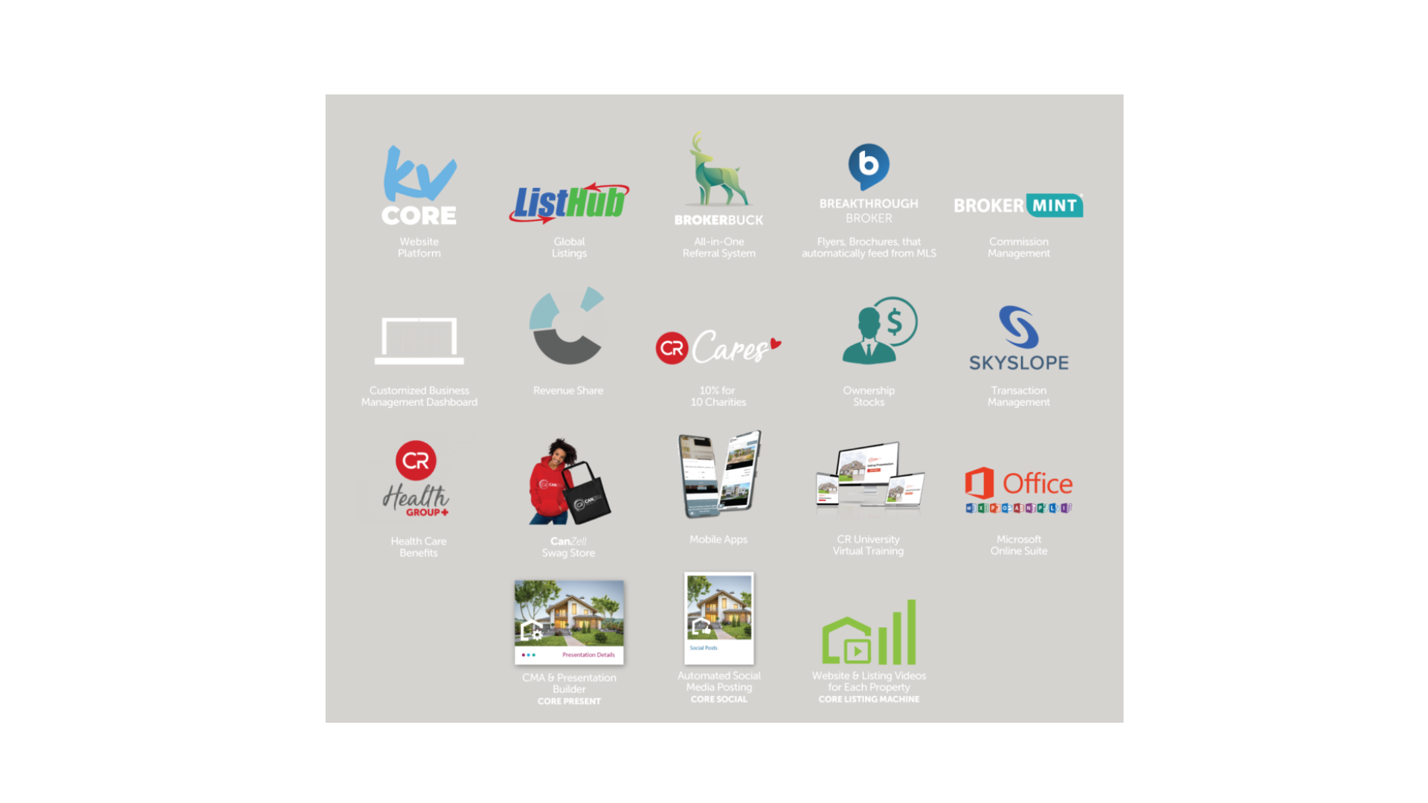
Let's Talk About L.O.T.S.
T Stands For Technology
T Stands For Technology
Technology is everything that you need to run your business. There is no one system in real estate. You don't need to buy everything you need for technology. We've already paid for it.

Slide 30
Let's Talk About L.O.T.S.
T Stands For Technology
And guess what? You don't even pay our technology fee. You're only paying 50 dollars a month for E & O Insurance, and that's it. You don't pay any technology fee and you shouldn't be buying any other technology because we've given you all the technology you need.

Slide 31
Let's Talk About L.O.T.S.
S Stands For Support
S Stands For Support
We have a live broker in every area. At CanZell, you don't have a “virtual avatar”. We have had people that joined us from other cloud brokerages, where they say if they needed help, they had to interact as this virtual avatar, and pull a number just like I would at the deli counter getting turkey. And it's just a nightmare. Not us!

Slide 32
Revenue Share
What You Can Get At CanZell
Think about your friends who are agents, working at another brokerage, and they get a 70/30 split. If they’re on a 70/30 split and they never cap, if they sell 30 houses with a $10,000 commission that's $300,000 in GCI, and they're giving $90,000 to the company. Think about that!

Slide 33
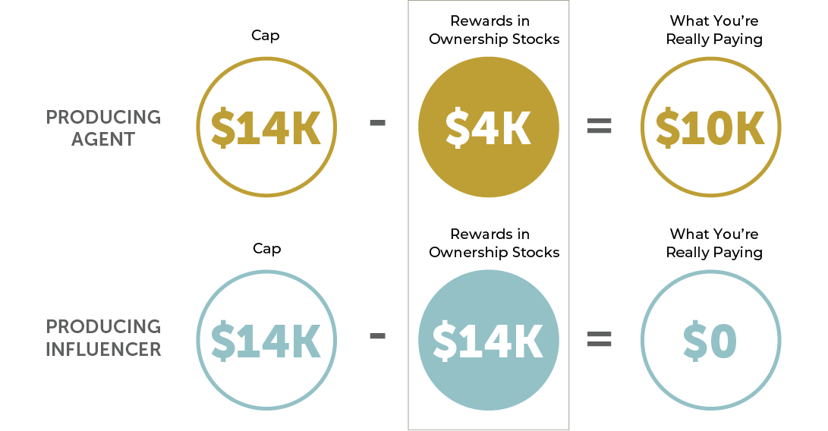
Revenue Share
What You Can Get At CanZell
By telling them about CanZell, you're going to be helping another agent! Instead of them giving away $90,000, that agent will only be giving away $14,000 to CanZell Realty, and getting $14,000 back in ownership stock.

Slide 34
Revenue Share
What You Can Get At CanZell
A lot of people don't realize that with our revenue share model, if someone closes on a house in January, they're getting revenue share the following month, so they’ll be getting all of that money right away.

Slide 35
Resources To Share
Now, go to JoinCanZell.com, click on videos and PowerPoints, and use these resources to share all this information with others. Last week, 2 agents sent out a simple message to 100 agents outside the company.
All they said was, “Hey, I really want you to watch these short videos. They are only a couple of minutes each.” They send it out to 100 agents.

Slide 36
Resources To Share
Guess what? Each one of these 2 separate people both had 1 person join, just like that! They had less than a 5 minute conversation with them, and they joined.
If you make a commitment to send out 100 emails, or 100 texts, you never know how many people are going to be interested and going to join. Imagine making that a daily habit, reaching out for just 30 minutes a day.

