Slide 1
Seller Fundamentals

Slide 2
Reaching the Seller

Slide 3
Reaching the Seller
Speed to Lead
When you first receive the lead, you should call and text the lead immediately. Speaking on the phone with someone is more effective than a text and listening and watching someone speak in person has an even bigger effect.

Slide 4
Reaching the Seller
The Double Dial
Call and then call right back. When you call a lead and they don’t pick up, hang up and call right back – most of the time they will pick up the second time but if they don’t, hang up and call back again! If they ask, “did you just call me twice?” just say, “Yes but I wasn’t sure if it went through”, Then move right into the seller call.

Slide 5
Reaching the Seller
Text
If you are unable to call a seller lead right away then text them. If they don’t pick up after your call attempts, then text them. Text is a great tool to reach sellers. Be brief and to the point as you normally would with friends. Don’t be too long-winded or overly professional. Say something along the lines of “When would be a good time to discuss your home?” or “Hi, you called about selling your home. I actually have a buyer interested in homes right in your area. Let’s talk.”

Slide 6
COMPS ON YOUR HOME:
“Heyyyyyy, This house just listed in your neighborhood. I just ran comps on your home again and your value is definitely there! Are you available for a quick chat right now?”
YOUR HOUSE WILL WORK:
I just had a buyer in your neighborhood that couldn't find what they were looking for. Maybe your house will work!🤩🌟 Can we chat for just a minute?

Slide 7
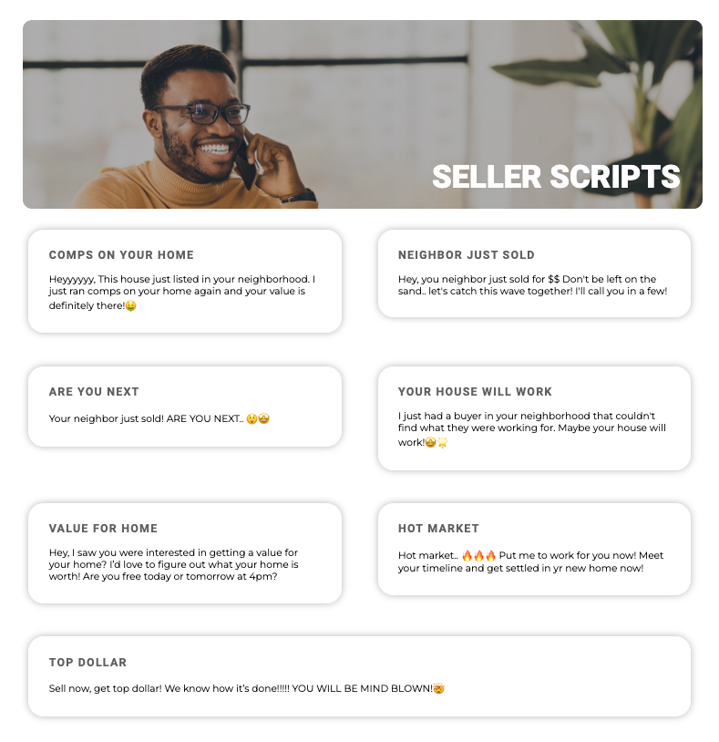
CLICK FOR SCRIPTS
https://joincanzell.com/sellerscripts/

Slide 8
Reaching the Seller
Email
Shortly after calling and texting you should always send a follow up email.

Slide 9
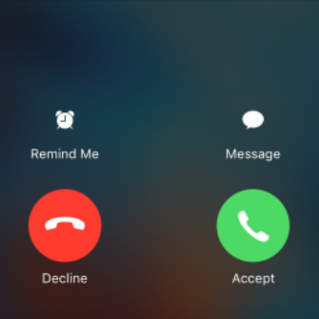
Reaching the Seller
PICK UP YOUR PHONE
You need to answer your phone even if you don’t recognize the number. Sellers can call back from other numbers.

Slide 10
Reaching the Seller
Keep on Reaching Out
Do not give up on leads. Your ability to reach someone is highest on your 1st attempt. With each attempt, up to your 5th attempt, the ability drops. At the 6th attempt to reach someone, your chance of success increases again, however you won’t have as high of a chance as on the 1st attempt.

Slide 11
Reaching the Seller
Vary Call Times
Try sellers at all different times of the day. Early morning and evening commute times tend to work best.

Slide 12
Seller Lead Plan

Slide 13
Day 1 – Call multiple times, text and send 1st email
Day 2 – Call and send 2nd email
Day 3 – Call and send 3rd email
Day 4 – Call, text, and send 4th email
Day 11 – Call, text, and send 5th email
Day 21 -- Call and text
Day 31 – Call and send 6th email
Day 41 – Call and send 7th email
Day 51 – Call, text, and send 8th email
Day 61 – Call and send 9th email
Day 71 – Call and send 10th email
Day 91 – Call, text, and email
Day 111 – Call and email
Day 131 – Call, text, and email
Day 161 – Call and email
Day 191 – Call, text, and email
Day 221 – No response, check in every 30 days

Slide 15
Preparing for the Appointment

Slide 16
Preparing for the Appointment
Send Items of Value:
1. Confirmation Email – Send this as soon as you hang up from booking the appointment. Always include a blog/article pertaining to something you discussed, marketing teaser, and link to where they can find information/reviews about you.
2. Calendar Invite – Sellers are much less likely to “no-show” for an appointment than buyers since you are typically going to their home, but this reminder still goes a long way.
3. Email a personalized Seller’s Guide from the Canzell Portal!

Slide 17
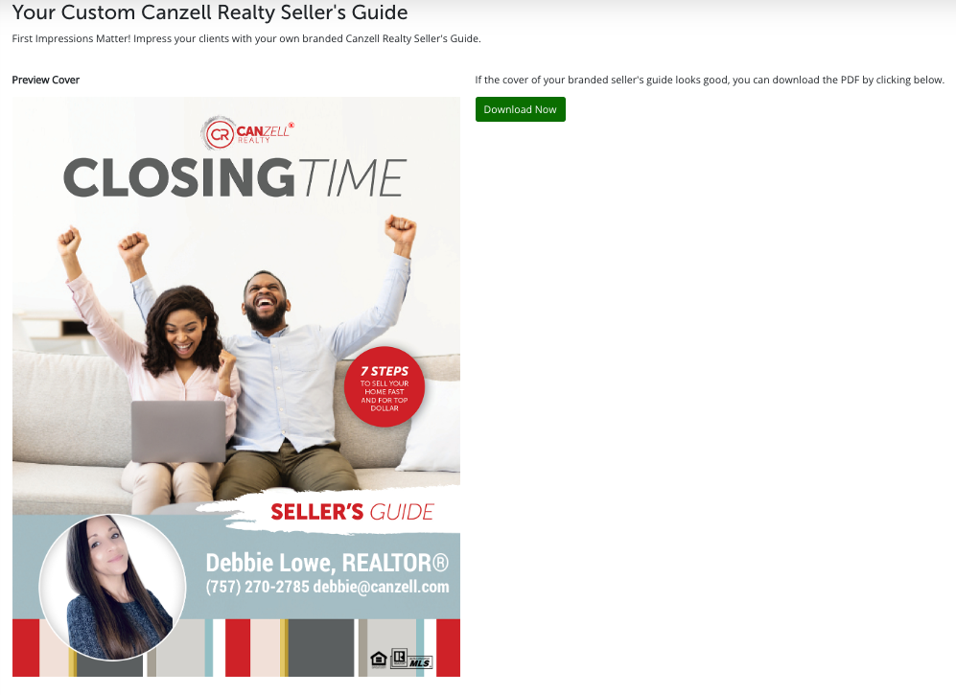

Slide 18
Preparing for the Appointment
Pre-Call:
The goal of the pre-call is to further build rapport with the seller(s), and to show them you are truly prepared. This is especially important if an appointment was booked for you by an Inside Sales Agent, but should be done with every seller. It allows you to re-confirm the appointment and make sure nothing has “changed” since you initially spoke with them.

Slide 19
Preparing for the Appointment
Final Preparation
1. Print 3-5 sold comparable listings. Use the “Public View” from MLS and only print one page of pictures along with the market history.
2. Be sure to obtain any “Market Reports” from MLS to show them some current data on the market in their 6 area. This is especially important in summer and fall, when we show “On Market Snapshots”, etc.
3. Put all of this information into a Seller Appointment Folder. Be sure it contains the correct paperwork and that the listing agreement has the correct commission percentage that you want.
a. Tip: If you know they are going to be a Sell/Buy or are unsure of their moving plans, be sure to have the correct
buyer paperwork with you as well.
b. Tip: Always have the commission typed in (not a blank line for handwriting it in).
4. Check the comparables one more time just prior to the appointment in case anything new has come on the market or any properties you had initially selected have had a status change.
5. If there have been any changes – like a sold or new listing – email them in advance to show again that you’re actively preparing for the appointment.

Slide 20
Steps of the Listing Appointment

Slide 21
Steps of the Listing Appointment
Drive-bys
Be sure to drive the neighborhood prior to the appointment. Make sure to stop by any comparable properties you are planning to discuss. This is especially important if you’re not familiar with the area.
Greeting (Rapport)
Be sure to arrive to the appointment a few minutes early. Ask them if it is okay to come in if the situation warrants it, don’t just barge in. If they are an S or C personality (reference the DISC personality test for more information) they will love you asking this. Be sure to compliment the house as soon as you arrive.
Walk-through The goal of the walk-through is to build rapport with the seller(s). Try and have any decision makers walk you around the home. Take some basic notes on the home.
Goal Recap Sit down (preferably at the dining room table), not directly across from them if you can. Review what you discussed during the pre-call and let them recap what they are trying to achieve. You will notice that their plans are often different than what they discussed with you over the phone. Don’t fall off your appointment plan when a seller says “I’m not selling for less than $X.” Keep moving forward and don’t get distracted!
Transition
Presentation The order of the presentation is:
• Team
• Professional Pictures / Floor Plans / Matterport / Drone
• Advertising: Digital Ads, TV, Radio
• Relocation

Slide 22
Pricing Net Sheet $

Slide 23
Pricing
Review the 3-5 comparable properties you brought. Start with the lowest price and work your way up to the highest. The highest comp should be no higher than the price you want them listed. Use the “CMA Sheet” to write the important details. At the end, ask them “Based on the information we reviewed, where do you think your home should be positioned in the market?” Try your best to get them to tell you a price. Multiple attempts at right price (seasonality matters).
Be sure to review with them the “21 Day Rule”. This is especially important if you are taking a gamble with the list price but does not hurt to mention with EVERY seller. It will be extremely important if you need to obtain a price reduction later.
21 Day Rule – Tell them “We will know within the first 21 days (14 in busier markets) if the price of your home is right or wrong. We will know one of three ways.”
1. – If we have a lot of showings and an offer(s), we know the home is priced appropriately.
2. – If we have showings and poor feedback or very few showings & no offers, we know the price of a home is slightly off. For example, if we have 10 showings on your home and 8 of them say we were overpriced, we would know we are slightly overpriced, wouldn’t you agree?
3. – If nobody comes to see your home, which is – don’t worry – quite unlikely, but always a possibility, then the price is more significantly off.
If the seller is initially thinking of a price WAY too high discuss “Plan A/B”.
Plan A/B – Tell them, “Obviously we all want your home to sell for as much as possible, but if the market decides $400,000 is too high for your home, what is plan B? We spend thousands of dollars marketing your home, so it is very important that I know what that looks like.”
Net Sheet (fillable one available on our Canzell portal)
Use the price they gave you to fill out the “Net Sheet”. Be sure to fill in a dollar value for the “Brokerage Fee” instead of a percentage. Once you have determined the “Net Proceeds,” ask them “Does that number work for you?”

Slide 24
Fillable net sheet (inser link)

Slide 25
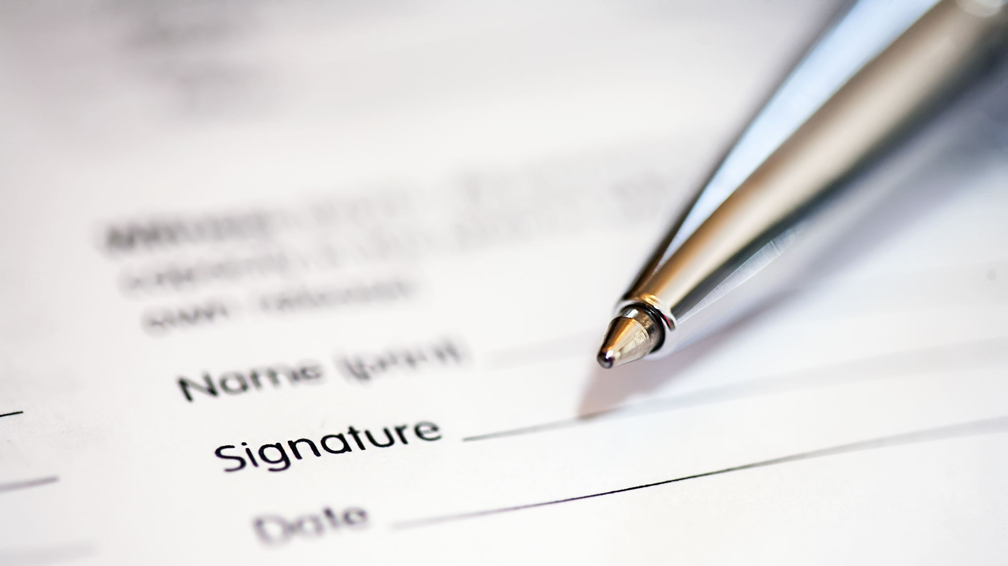
Signing the Listing Agreement

Slide 26
The Seller Who is Also Buying
Many times, people who are selling are also looking to buy – if they’re looking to relocate somewhere in or close to your territory, this is a Sell/Buy client!
Always remember, the sell/buy client is very nervous about:
Ending up homeless
Ending up with two homes
The overall process

Slide 27
What To Do When Your Home is Shown?
Whenever possible, please be away from your home when a showing is scheduled.
Storage is something that every buyer is looking for and can never have enough of. Take half of the stuff out of your closets and organize the rest.
We love pets, however, its best to remove them and all evidence of pets when you have a showing.
Like Motel 6 says “We’ll leave the light on for you”
Keep the lights on when you leave for a showing.

Slide 28
What About A Buyer?
Must Do’s:
Show More Than One – Anytime you go out and show a buyer home(s) your goal should be to show them 2-4 homes. No more and no less if you can. It is very important to try and see at least two. Reason being the more time you spend on the first showings the better to build rapport.
Be Prepared – First impressions last so if you cannot get into the lockbox, your supra isn’t updated, you show up late or even too early and the sellers get mad it will turn the buyer off. Be on time or slightly early and be ready!
Listing Sheet – Bring a listing sheet with you to every showing. This will show the buyer that you are prepared. Some agents don’t bring them and tell their buyers that they have “gone green” as they pull the listing sheets up on their phones. This is not a bad thing. If you opt to do this then do it all the time so that the buyer doesn’t think you just forgot them. If you print out a listing sheet be sure to keep a copy with you.
Know the Houses – When you first a buyer those first few homes, you need to work hard to show them that you know the houses and even the neighborhood, the school(s) that are in that district etc. Once you have been out with a buyer a few times and your rapport builds up, you can get away with not knowing a house or the neighborhood as well but don’t let this happen on the first or second time out with the buyer. Casually point out some pros and cons they might not ordinarily see, such as a newer roof, furnace, etc. You may also want to point out some things that might need repair, but be careful not to alarm the buyer.
After First Showings – After your first day of showings ask the buyer(s) questions like: What did you like/ dislike about the house? Did you like the area? This house required a bit of updating, was that ok or was it a turn off? What was your top pick of the day?

Slide 29
Keep the Buyer Active
Must Do:
Real Estate sales is a contact sport. If you are not in contact with the buyers, even if you have them signed up and have showed them homes, you risk losing them. Educate them, “friend” or “connect” with them on social media sites like Facebook, etc. During the first quarter of the year you need to educate and counsel your buyer on how the low inventory will not last forever. Send blogs, videos, posts, texts etc.

Slide 30
Always Be Looking
Remember, buyers want to know you are LOOKING. That is the number one thing that makes them feel like they need you. Be sure to make them know you are looking and you should be looking! This is especially critical in a low inventory market because buyers are much more likely to get frustrated.

Slide 31
Take Control
Once they find the house they want, their emotions will get higher and you need to take control. Show the buyer that you have everything under control and that you will guide them through this.

Slide 32
Your Demeanor During Transactions, Past or Present:
There is a lot to be said about your demeanor during transactions, in the past and when dealing with the listing agent for the said property. If the listing agent happens to be “lazy” and makes comments like “Sorry I missed your call, I was out golfing/at the beach,” respond with, “No problem, I was too”. Mirror their demeanor. This way the agent won’t feel like you are going to be a nuisance through the transaction when you follow up with them or are persistent like a good agent should be, and how you should be, without letting them blatantly know that up front.

